Slide 1
Network Security Labs

Slide 2
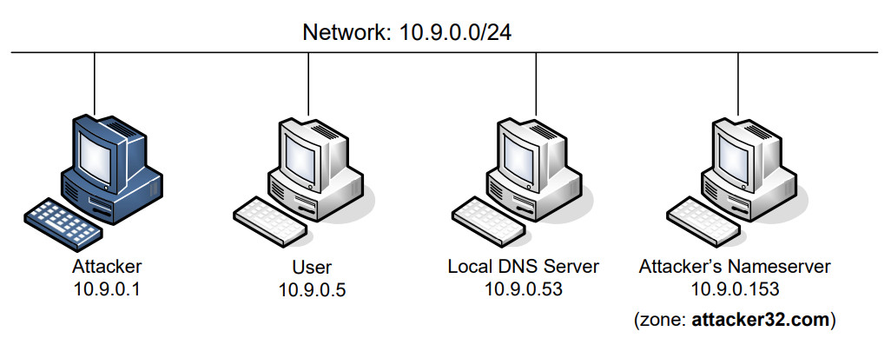
Lab Settings
Local DNS server:
Use fixed 33333 port
Runs BIND 9 DNS( configuration file in /etc/bind/named.conf)
DNSSEC is turnned off
Use rndc to check and clear DNS cache
Attacker’s DNS server: resolve attacker32.com & example.com

Slide 3
Verification
dig ns.attacker32.com in the user’s machine
Query the domain name of the attacker’s site.
It will be answered by the attacker’s DNS.
dig www.example.com
By default, answered by local DNS -> root -> .com -> example.com
dig @ns.attacker32.com www.example.com
Specify not to use local DNS resolver
Answered by the attacker’s DNS

Slide 4
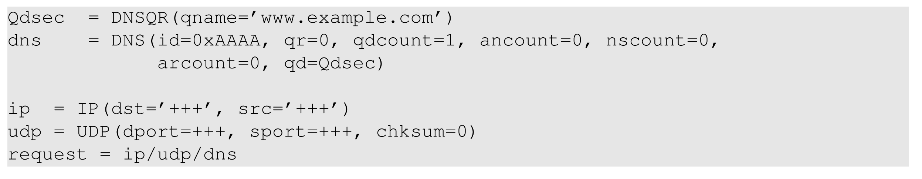
Task 2 Construct DNS Query
You may use Python/C to construct DNS query
C is faster, which may be important in later tasks.
Use wireshark to capture queries and replies.
The replies are important for later tasks.

Slide 5
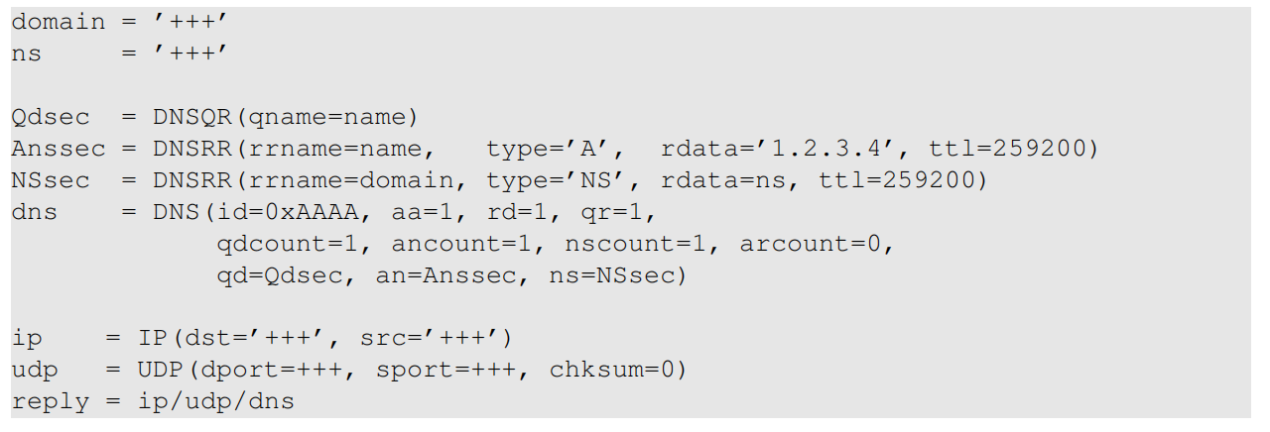
Task 3 Spoof DNS reply
We want to forge replies for our query.
Replies have similar format to queries.
To feed the replies to the victim local DNS server
How to know what should be filled in the replies?
Use wireshark to capthre the replies in the task 2.

Slide 6
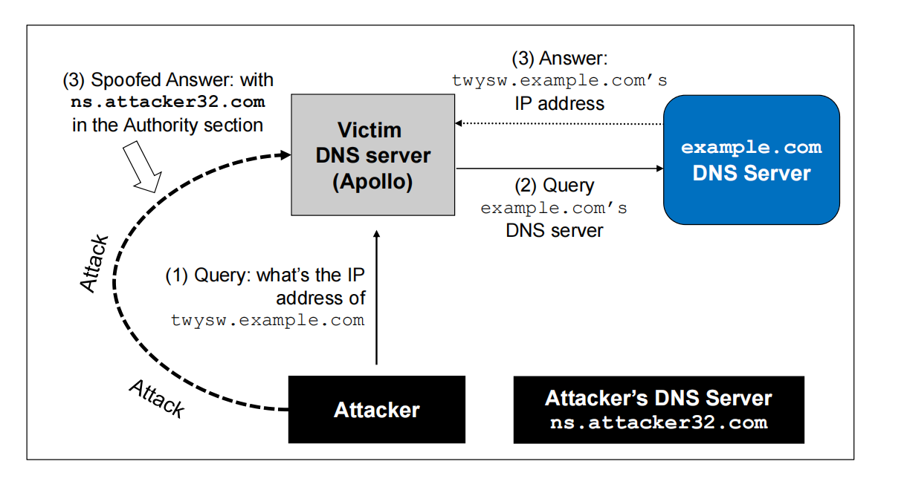
Kaminsky in our settings

Slide 7
Task 4 Kaminsky Attack
Hybrid Method
Use python to generate query and reply.
Python is too slow to generate that many packets.
Use C to repeat sending replies with TXID changed.
Steps:
Send a query with random domain prefix.
Send a forged reply packet.
repeat step 2 until all TXID tried.

Slide 8
Task 5 Verification
Check the DNS cache of Local DNS server.
rndc dumpdb -cache && grep attacker /var/cache/bind/dump.db
Dig example.com again to see if example.com is resolved by the attacker’s NS server
dig www.example.com

